Slide 1

Week 11 Usability
COM4012M Programming 02
1

Slide 2
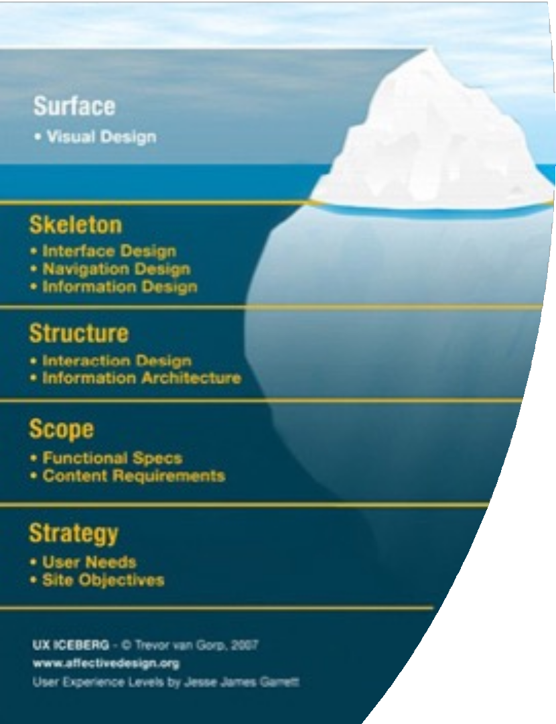
2
What we have done so far

Slide 3
Usability cuts across all levels of the user experience.
You can see its influence most directly:
Visual and Interface Design
Also has a significant role to play in:
Interaction Design
Navigation Design
Information Architecture
Information Design
Usability and the User Experience

Slide 4


Will be teaching you usability as
the main and most important technique for testing your UX design
Usability and
the User Experience
If a site isn’t usable then the UX has not been designed correctly

Slide 5
Usability
Usability is how well a user can use a system’s functionality.
Dimensions of usability:
Learnability: is it easy to learn?
Efficiency: once learned, is it fast to use?
Memorability: is it easy to remember what you learned?
Errors: are errors few and recoverable?
Satisfaction: is it enjoyable to use?

Slide 6




Depends on the user:
Novice users need learnability.
Infrequent users need memorability.
Experts need efficiency.
Usability Dimensions
Vary in
Importance

Slide 7
User Experience
Users have varying experience levels:
Domain experience.
Example: A financial analyst using a trading platform versus a casual user.
Application experience.
Example: A user who regularly uses a content management system versus someone who is new to it.
Feature experience.
Example: A user familiar with advanced search filters versus a beginner who only knows basic navigation.

Slide 8


User Interfaces are Hard to Build
User interface takes a lot of software & development effort.
Usability is therefore the most important aspect.
UI accounts for ~50% of:
Design time
Implementation time
Maintenance time
Code size

Slide 9
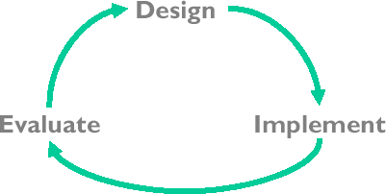
Usability Engineering is a Process
Usability is a test
How good is your UX design.
Usability dimensions: ways to evaluate UX design process.

Slide 10
Top 10 Mistakes in Web Design https://www.nngroup.com/articles/top-10-mistakes-web-design/
Bad Search (unable to handle typos plurals hyphens etc.)
PDF Files for Online Reading (good for printing bad for navigating)
Not Changing Colour of Links (help distinguish past & present)
Non-Scannable Text (use headings, lists, bold, paragraphs & inverted pyramid)
Fixed Font Size (resize text for different parts & have a button to increase text size)
Page Titles with Low Search Engine Visibility (for bookmarking)
Anything that Looks Like an AD (people try to ignore ads)
Violating Design Conventions (key one being having a consistent design)
Opening New Browser Windows (lose control & use of back button)
Not Answering the Users’ Questions (users want to achieve their goal)

Slide 11
A system is usable if users can do what they need to do:
Quickly.
Easily.
If they make mistakes the system corrects them without fuss.
Usability Criteria
Many metrics can be measured in terms of
Task performance – e. g. how long to buy something/how many clicks.
User cost – e. g. The amount of effort or information required from users to complete tasks.
User satisfaction – How users feel about their experience—emotional responses, enjoyment, frustration, etc..

Slide 12
Usability testing refers to evaluating a product or service by testing it with representative users.
Typically, during a test, participants will try to complete typical tasks while observers watch, listen and takes notes.
The goal is to identify any usability problems, collect qualitative and quantitative data and determine the participant's satisfaction with the product.
No one test – a bank of tests is usually required.
Usability Tests/Evaluation
(usability.gov)

Slide 13
When you know what your users’ goals are you can formulate task scenarios like for example:
“You're planning a vacation to New York City, March 3 − March 14. You need to buy both airfare and hotel. Go to the American Airlines site and JetBlue Airlines site and see who has the best deals.”
Make the task & scenario realistic.
Make the task actionable. Ask the user to do an action rather than telling them how they would do it.
Avoid giving clues or describing steps. Avoid step by step instructions.
Turn User Goals into Task Scenarios for Usability Testing
https://www.nngroup.com/articles/task-scenarios-usability-testing/

Slide 14
Types of Task Scenarios https://www.userfocus.co.uk/articles/testtasks.html
Scavenger Hunt – Ask your user to find/do something that has one clear answer.
Reverse Scavenger Hunt – Show users the answer and then ask them to find it.
Self-generated tasks – No goal, instead you ask the user what they’d expect to do with the site then test it.
Part self-generated – Design an overall goal then get the user to fill the gaps.
‘Skin in the game' tasks – Users react differently when it’s not their money – less risk. Pretending to buy a holiday vs really buying one. Give them a reimbursement or voucher.
Troubleshooting tasks – something has gone wrong how do users respond? Try recreate an issue and ask users to solve it.

Slide 15
Performance is assessed against Evaluation criteria:
What metrics / how to evaluate this?
Which criteria (learnability, memorability etc) to select depending on the type of system and context of use.
Threshold of what is acceptable (benchmark for pass/fail) should be determined prior to evaluation.
What is an evaluation?

Slide 16
Goal
Statement of evaluation question.
Summative (final) or Formative (low stakes) evaluation?
Scope
Full/final or iterative evaluation?
Working system, prototype, design?
Resources (time, number of staff)
Skills (required to perform methods)
Evaluation Goal and Scope

Slide 17
Empirical evaluation:
Observation-based (key-stroke, eye-tracking, think aloud); At the time.
User report-based; Done after.
Analytic evaluation:
Detailed analysis of user-system interaction to predict performance: Keystroke Level Model (KLM), Goals, Operators, Methods and Selection (GOMS), cognitive walkthrough.
Heuristic evaluation - identify design problems in a user interface, judging against a set of guidelines make systems easy to use.
Evaluation methods

Slide 18







Observation-based evaluation
Observe users interacting with system
In usability lab
In workplace
Usually collect a range of data
Range from
formal task-based assessment
(benchmarking) to less structured observation
Long-term observation

Slide 19
Observation-based Data Collection
Task measures: task completion, time,
errors
System logs
Video recording: screen, keyboard, user
Audio recording (especially for
“thinking aloud”)
Eye-tracking
Physiological responses
User feedback can be collected throughout session or at end
– Online questionnaire

Slide 20

User report-based evaluation
Users are requested to provide information about their usage of a system.
Assessment without having to observe the system actually in use.
May have number of functions during development:
Assessing performance of existing system (e.g., input to requirements for new release/system).
Assessing performance of prototype (input to continuing design).
Assessing performance of new system (input to redesign, training).

Slide 21
Analytic Techniques
Techniques generally intend to predict system performance
NOTE: distinction between formal and informal analysis
– informal = implicit representations of system (e.g., in mind of practitioner; expert's opinion)
– formal = explicit model of system (e.g., specified in notation)
KLM, GOMS, Cognitive Walkthrough
How close are users to our intended model?

Slide 22
Expert Assessment
HCI expert systematically "walks through" the design, as if they were a user:
Very common.
Jakob Nielson & Petrie Powers developed guidelines and techniques.
Specialist evaluates system performance on basis of expected behaviour of users.
Will employ some analytic technique.
Pros:
Fast assessment.
Coherent recommendations for changes.
Cons:
How good is the expert?
Knowledge of users & domain.

Slide 23


Heuristic Evaluation
THIS IS THE MOST STRAIGHTFORWARD AND LEAST RESOURCE INTENSIVE OPTION.
JAKOB NIELSEN CONSIDERS THIS IS THE BEST OPTION IN TERMS OF VALUE FOR MONEY.

Slide 24
The Heuristics
Visibility of system status.
Match between system and the real world.
User control and freedom.
Consistency and standards.
Error prevention.
Recognition rather than recall.
Flexibility and efficiency of use.
Aesthetic and minimalist design.
Help users recognize, diagnose and recover from errors.
Help and documentation.
Source: Nielson 2000 https://www.nngroup.com/articles/ten-usability-heuristics/

Slide 25
Heuristic evaluation
“Do-it-yourself” or “discount” specialist walkthrough
Goal: find the usability problems in the design so that they can be “weeded out” as part of an iterative design process.
How:
Group of evaluators (between 3 and 7) examine the interface and judge its compliance with recognized usability principles (the "heuristics").
Rate the “severity” of problem and plan how to fix them.

Slide 26
Severity ratings
Derive a rating for the problem based on
Frequency
Impact
Can be used to
Set priorities (fix most serious problems first)
Allocate resources
Provide a rough estimate of the need for additional usability efforts.

Slide 27
Pros and Cons: Heuristic Evaluation
+ Advantages:
Detects both major (42%) and minor (32%) problems in UI.
More effective than single specialist.
Can be used on designs.
“Realistic” approach.
“Severity rating” helps to set priorities.
- Disadvantages:
Groups can develop their own bias.
Doing it properly is not that cheap.
New technologies (Web, Multimedia, Virtual Reality) may have specific problems not covered by the Heuristics.

Slide 28
Choice of technique depends upon context.
Stage of system development.
Resources available.
Time.
Evaluators.
Users.
Laboratory/equipment/facilities.
Acceptability of intrusion on users, etc.
Type of output required.
Precision / reliability.
Diagnostic information.
Level of behavior of interest.
Choosing evaluation techniques

Slide 29
Online Free Usability Metrics Tests
Speed:
GTMetrix - http://gtmetrix.com
Pingdom - http://tools.pingdom.com/fpt/
Navigation:
UXPunk - http://www.optimalworkshop.com/?uxp_welcome=1 Colour - https://www.colorcombos.com/
Readability:
Readability Test - https://readable.com/
Gunning Fog Index - http://gunning-fog-index.com/

Slide 30
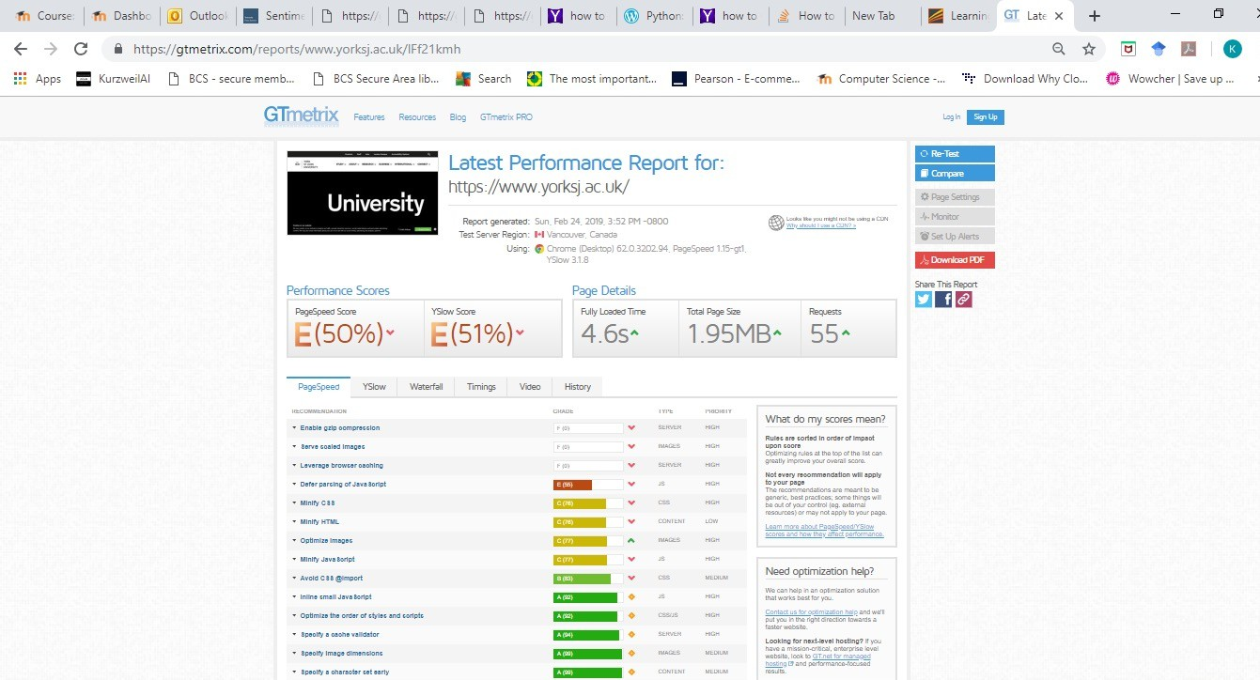
Gmetrix Results

Slide 31
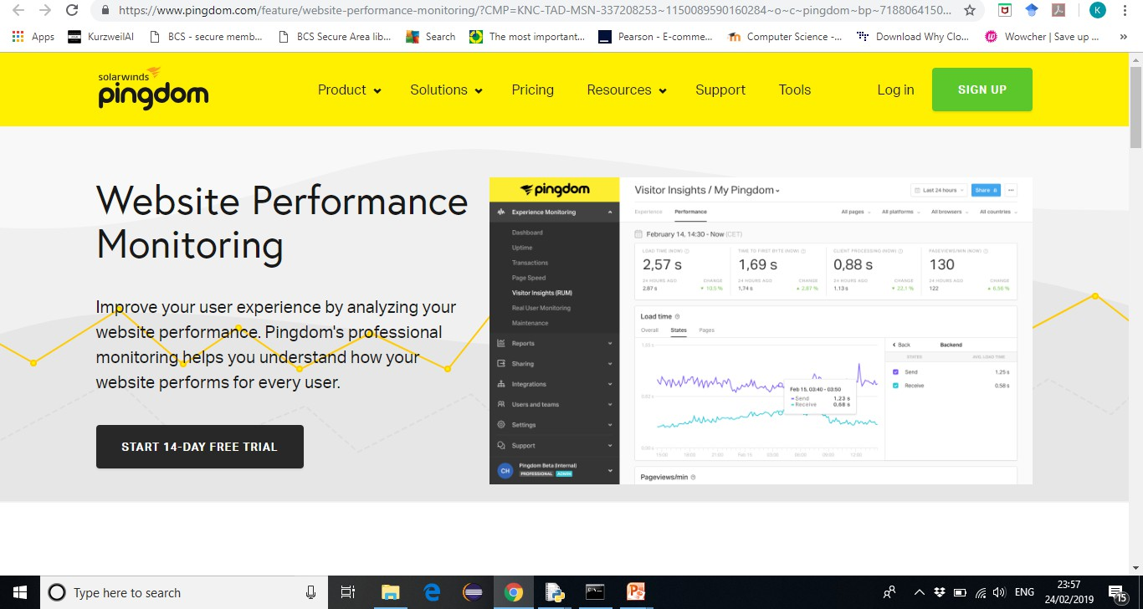
Pingdom

Slide 32
General Usability Assessment Tools
Loop11 http://www.loop11.com Usabilla https://usabilla.com

Slide 33
Further Reading
Usability 101: Introduction to Usability http://www.useit.com/alertbox/20030825.ht ml

Slide 34
Exercise
Choose a website or use sections of you own projects and perform some of the usability tests below. Some sites may need you to sign up, but don’t feel required.
Speed:
(sign up) GTMetrix - http://gtmetrix.com
Pingdom - http://tools.pingdom.com/fpt/
Navigation:
(sign up) UXPunk - http://www.optimalworkshop.com/?uxp_welcome=1
Colour - https://www.colorcombos.com/
Readability:
(sign up) Readability Test - https://readable.com/
Gunning Fog Index - http://gunning-fog-index.com/

